Slide 1


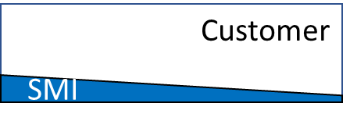
Implementation models
End to End
Hybrid
Advisory
Customer / SI / Partner
Customer / SI / Partner
SMI owns and manages implementation
Planning, design & configuration done by SMI resources based on customer requirements
Customer provides business SME’s
Customer owns implementation (along with SI / Partner)
Project starts with SMI leading planning, design and configuration
Customer resources are deeply involved in all areas from start
As customer resources gets knowledgeable they gradually take over more responsibility
Project starts as End-to-End and ends as Advisory
Customer owns implementation (along with SI / Partner)
SMI delivers initial kick-off workshop to assist with planning and guidance
Planning, design & configuration done by Customer resources,assisted by SMI
SMI provides guidance and problem solving assistance through out project
Good for:
Minimum customer resources needed
Timeline and quality assurance
Rapid enablement of customer resources
For experienced customer with objective to build own CoE

Slide 2
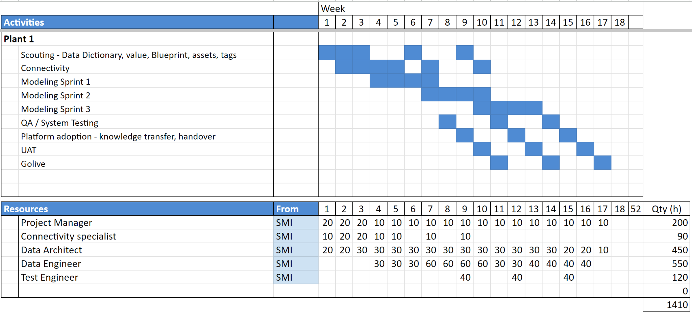
Sample Project Plan - End to End

Slide 3
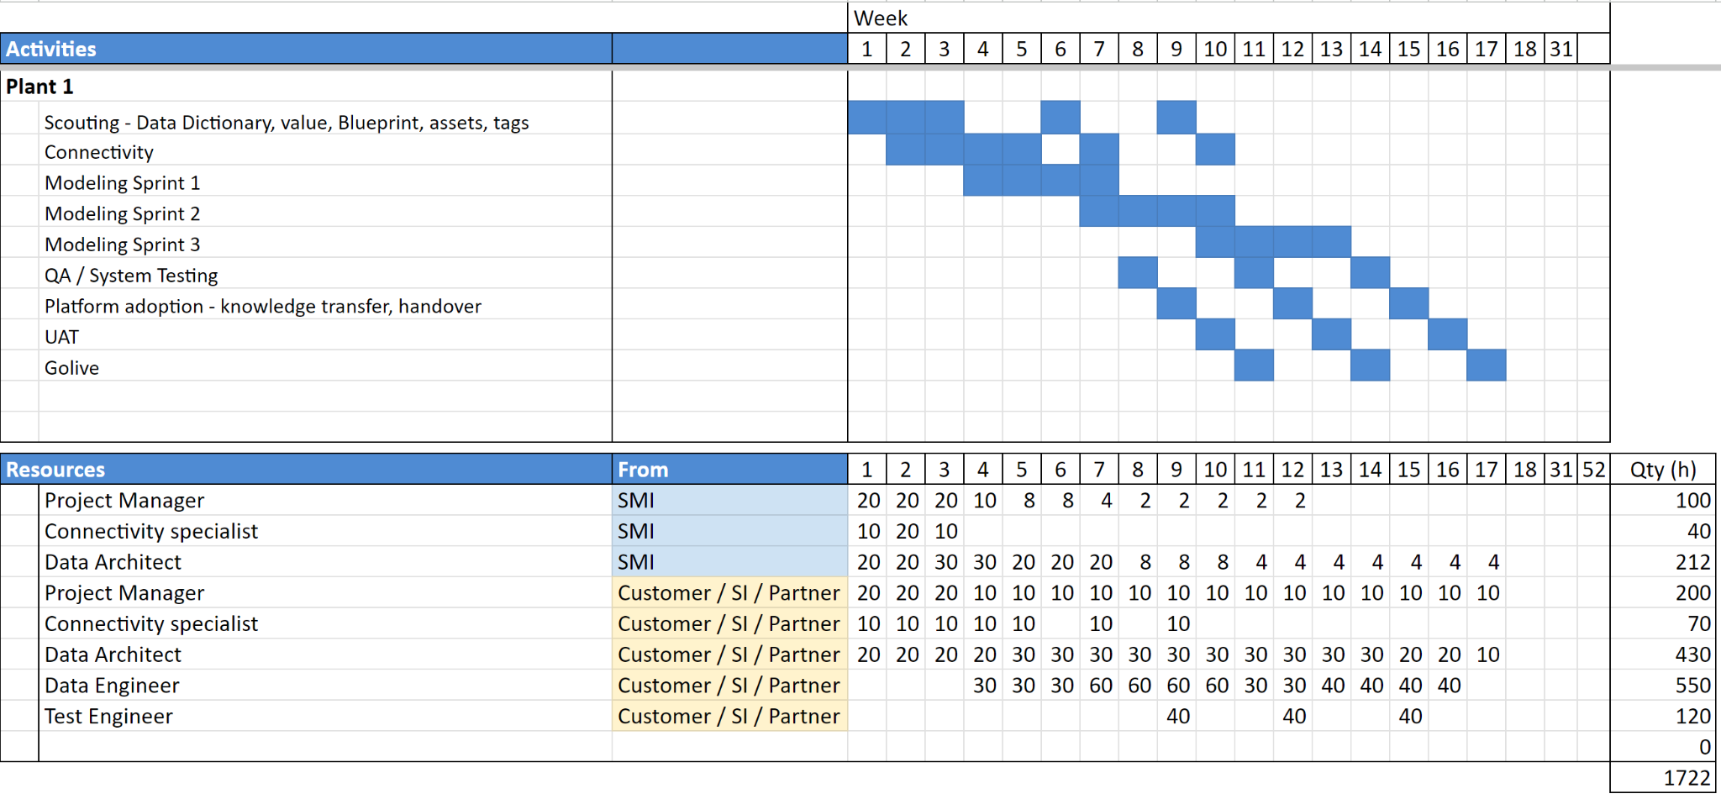
Sample Project Plan - Hybrid

Slide 4
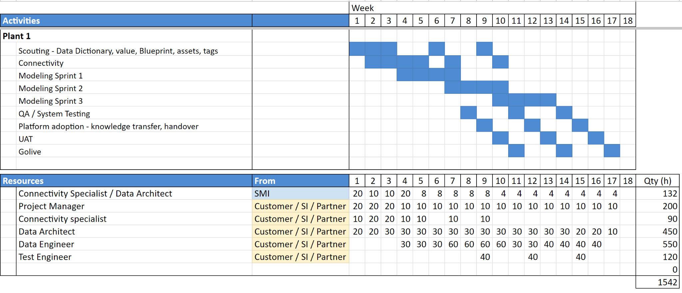
Sample Project Plan - Advisory

